Slide 1
Working with the SharePoint Framework
March 15th, 2017

Slide 2
Intro
SharePoint Framework Overview
Requirements and Considerations
Demo
-SPFx scaffolding a new project
-SPFx Fantastic 40
-dev,test,publish – tell this story

Slide 3

Eric Skaggs
eskaggs@outlook.com
@skaggej
http://www.ericskaggs.net
Catapult Systems
Pluralsight Author
https://github.com/skaggej/spfx

Slide 4
SharePoint Framework Overview
Why and What? #SPFx

Slide 5
#SPFx Overview – Why?
Need for cloud-capable, client-side solutions
Need for configuration options in web parts
Content Editor and Script Editor web parts, for example
iFrames are slow and interfere with responsive design

Slide 6
#SPFx Overview – What?
Page and web part model supporting client-side dev
Easy integration with SharePoint data
Support for open source tooling
Modern web technologies
Works for SharePoint Online and on-premises
No iFrames, natively responsive, lifecycle access, framework-agnostic, support for both classic and modern experiences

Slide 7
Requirements and Considerations
How? #SPFx

Slide 8
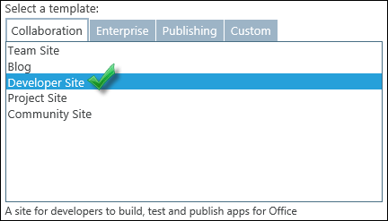
#SPFx – How?
Use SharePoint Online to test what you build!
Create an app catalog site collection
Create a development site collection

Slide 9
Option #1 – Configure Your PC
Install Node.js
Install a code editor
Install TypeScript
Included with Visual Studio Code
Install Yeoman and gulp
Install Yeoman SharePoint generator
Install other tools you might need or want
Ready to go!

Slide 10
Option #2 – Docker
Install Docker
Open the command line
mkdir spfx-first-project
docker run -h spfx -it --rm --name spfx-first-project -v /D/docker/spfx-first-project:/usr/app/spfx -p 5432:5432 -p 4321:4321 -p 35729:35729 waldekm/spfx
Ready to go!

Slide 11
SharePoint Framework Demo
Awesome! #SPFx

Slide 12
Resources
Set up your Office 365 tenant: http://bit.ly/2c8L50Z
Set up your dev environment: http://bit.ly/2mNRyH4
#SPFx Overview: http://bit.ly/2bWijSN
#SPFx on Docker: http://bit.ly/2mysqnj (by @waldekm)
Docker: https://www.docker.com

